Slide 1

Different brains and
Complementary Skills
Different brains in the office.
Building organisational value through the complementary skills of diverse staff expertise.
Chris Malcher, December 2025
(concept created May 2023)

Slide 2
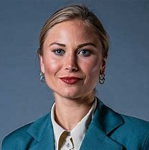

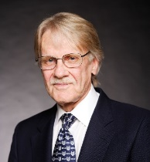
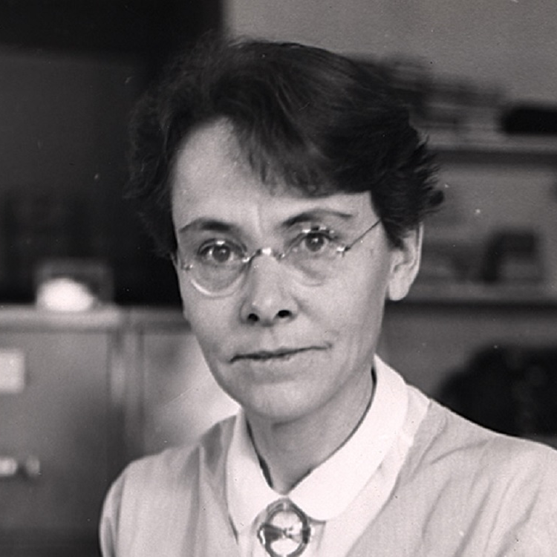
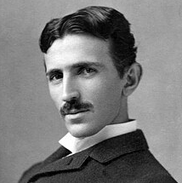
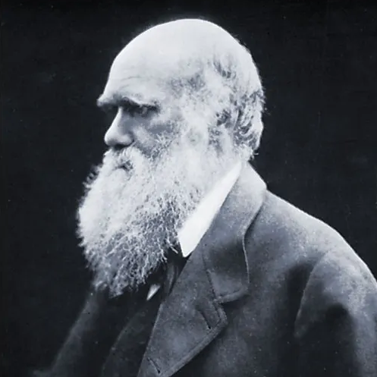
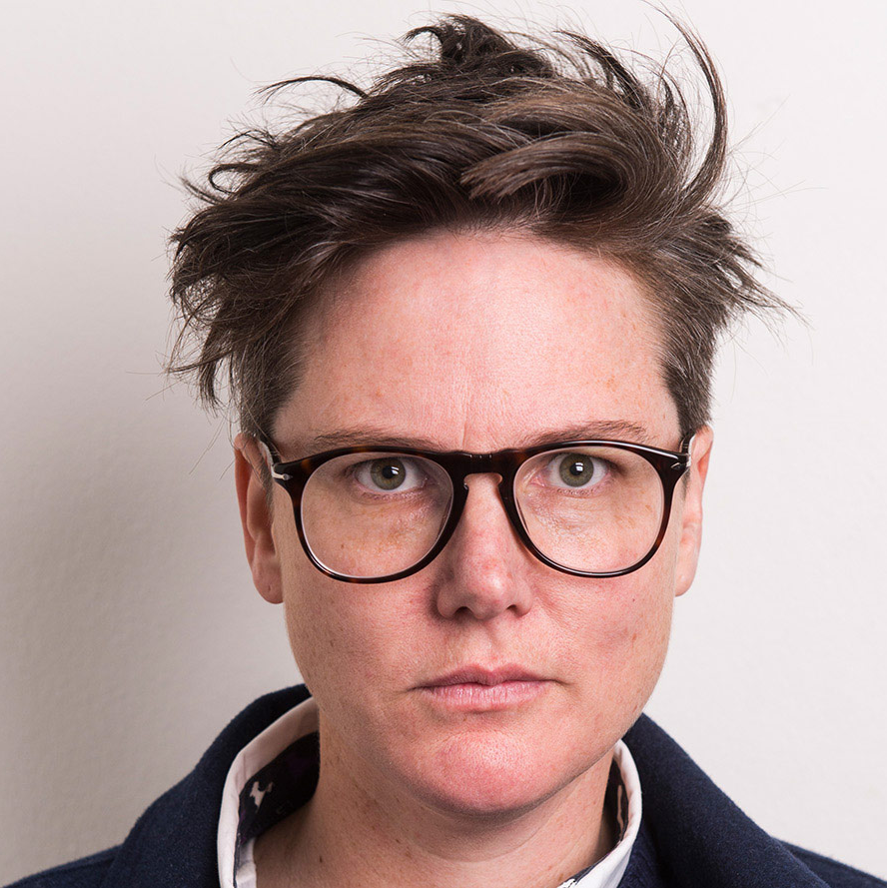
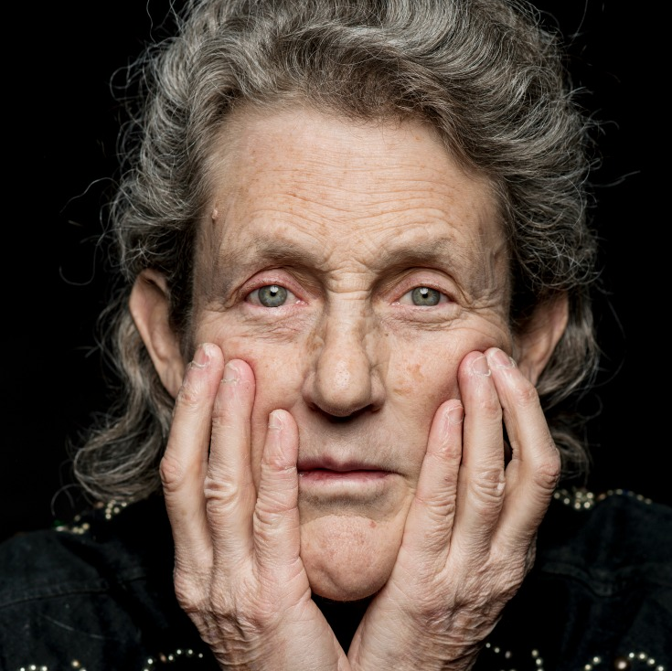
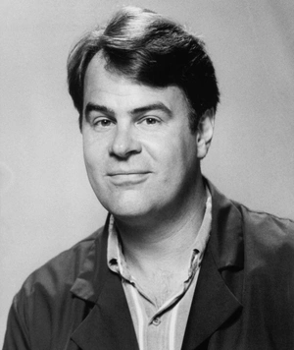
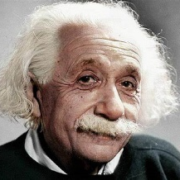
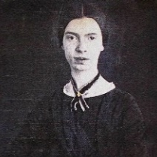

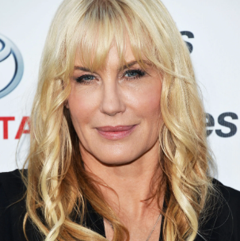

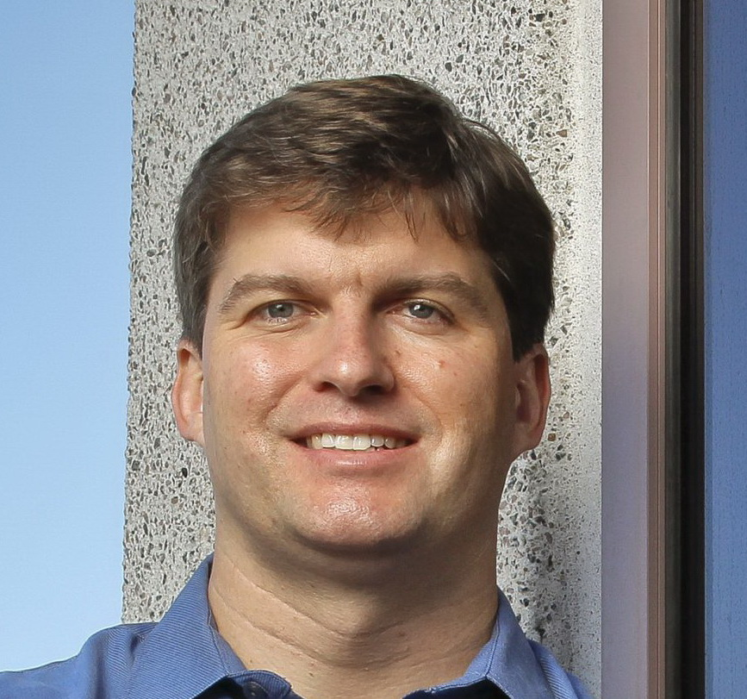

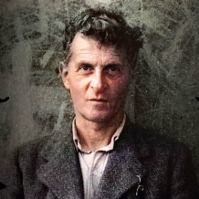
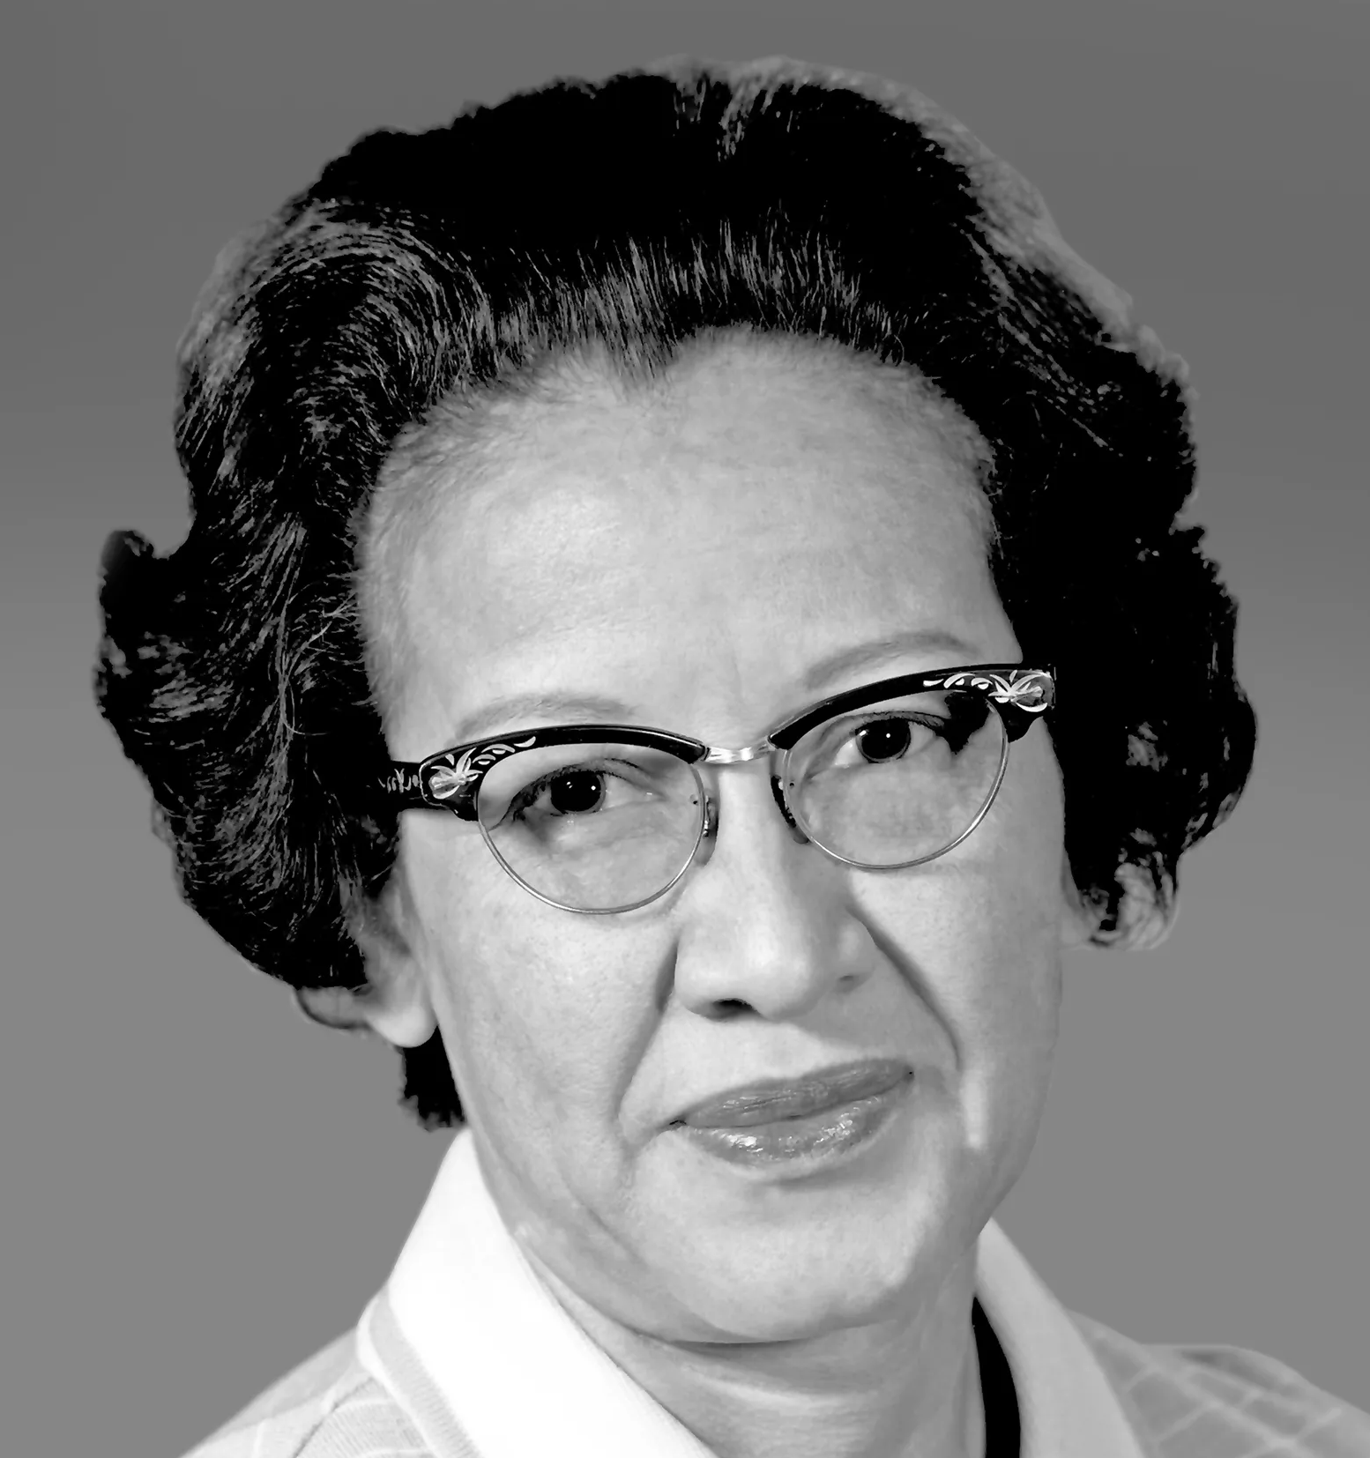
What does this group of people have in common?
All these people share an uncommon characteristic.
Grace Tame
Australian of the Year, 2021
Bill Gates
Entrepreneur
Vernon Smith
Economist &
Nobel Laureate, 2002
Barbara McClintock
Scientist &
Nobel laureate 1983​
Nicola Tesla
Inventor
Charles Darwin
Naturalist
Hannah Gadsby
Comedian
Temple Grandin
Animal Scientist & Author
Dan Aykroyd
Actor & writer
Albert Einstein
Physicist &
Nobel Laureate 1921​
Emily Dickinson
Writer​
Lewis Carrol
Author
Daryl Hannah
Actress
Greta Thunberg
Environmental Activist
Michael Burry
First to predict the Global Financial Crisis
Hildegard Von Bingen
12th century nun / musician​
Ludwig Wittgenstein
Philosopher
Katherine Johnson
Rocket scientist & USA presidential medal recipient.

Slide 3

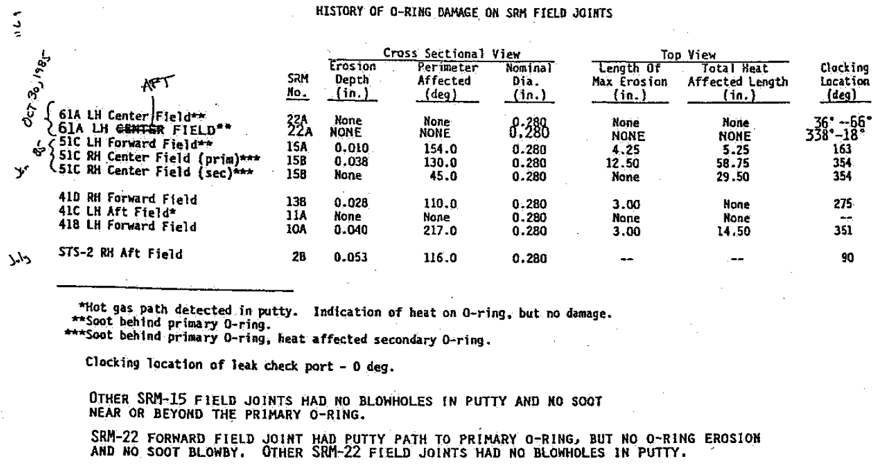
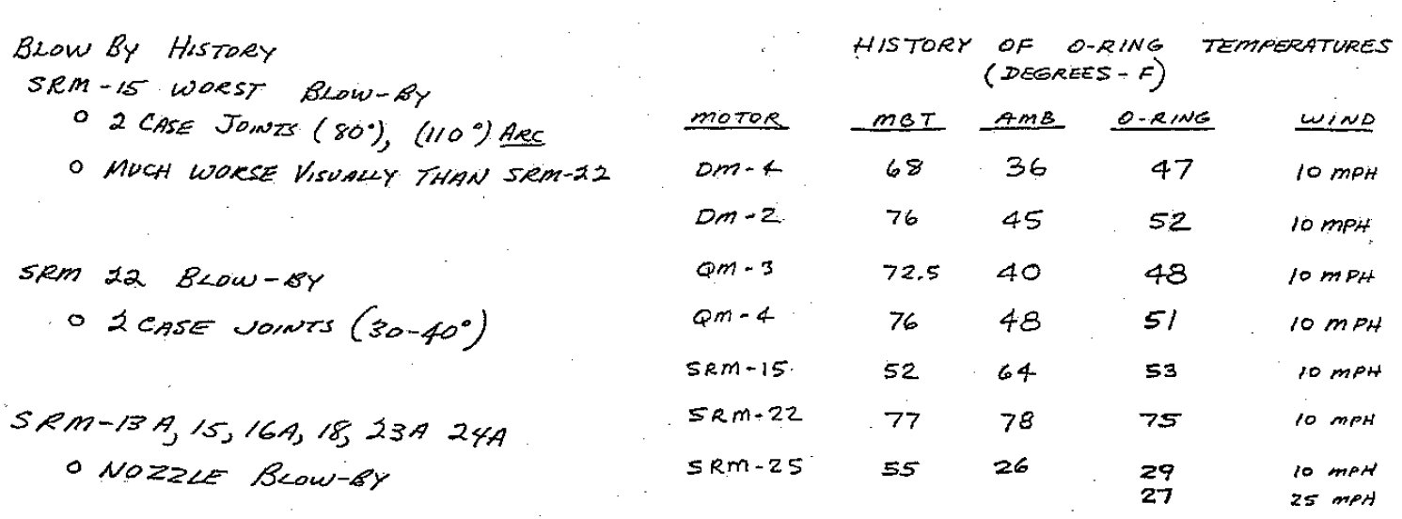

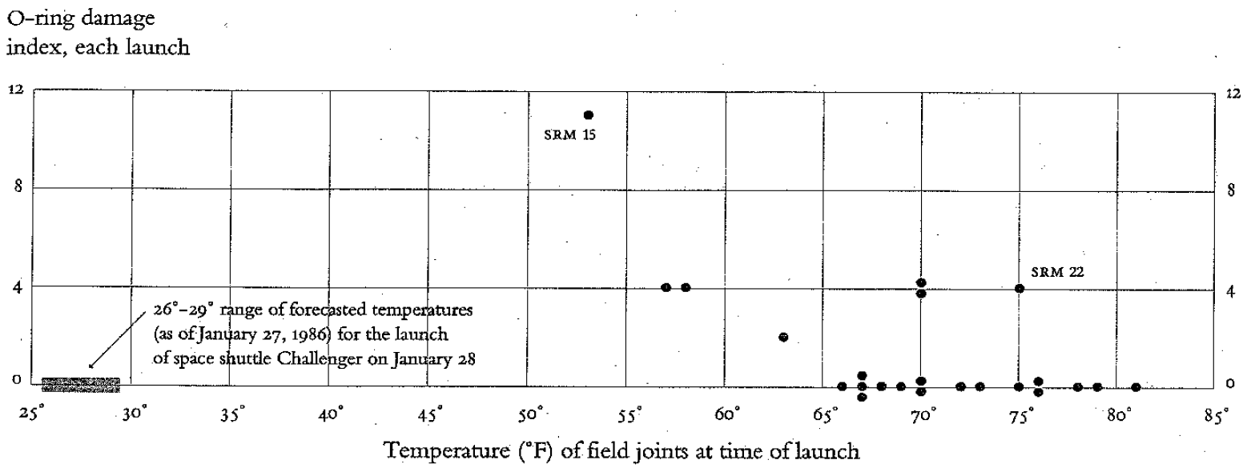
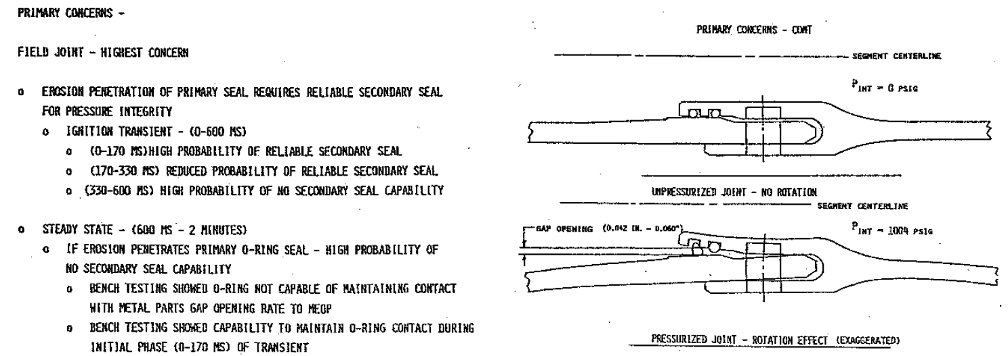
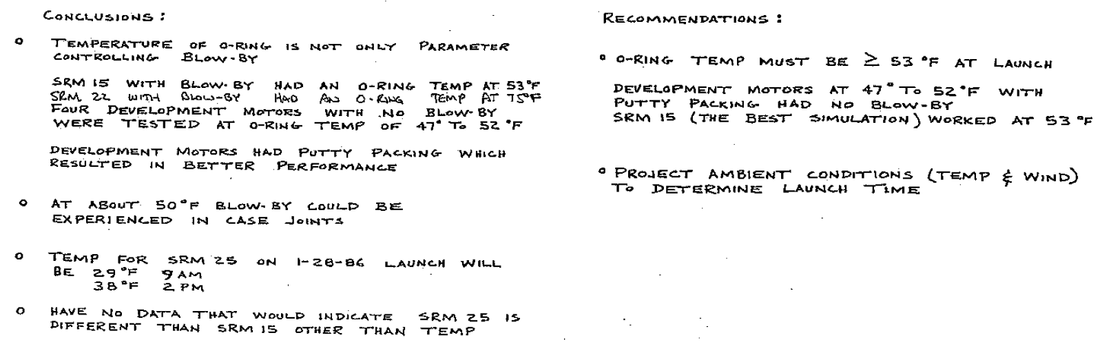
A disaster that could have been avoided
A report from a team of engineers and rocket scientists tried to warn of what became the Challenger space shuttle disaster of 1986

Slide 4


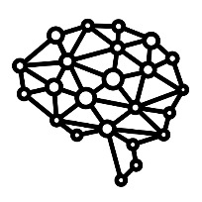
A spectrum for consideration
A simplified view (to the point of simplistic) of different areas of expertise.
People Specialists
System Specialists
Very strong and intuitive understanding of people
At the extreme at this end of the spectrum are, we might imagine, Empaths.
Very strong intuitive understanding of highly-complex rules-based systems.
At the extreme an this end of the spectrum are people with autism. Our focus here is specifically on Level 1 Autism (the more mild form).

Slide 5
The People Specialists
People Specialists demonstrate a high-level of understanding of people, group dynamics, and interpersonal relationships
People Specialists
Level of intuitive understanding of people​
System Specialists
Notes:
Level of intuitive understanding of people

Slide 6
The System Specialists
System Specialists demonstrate a high level of intuitive understanding of highly-complex rules-based systems
People Specialists
Level of intuitive understanding of highly-complex rules-based systems
System Specialists
Notes:
Level of intuitive understanding of people

Slide 7
Every point on this spectrum brings different skills – which add up to similar value
People Specialists
System Specialists
Notes:
Level of intuitive understanding of people

Slide 8
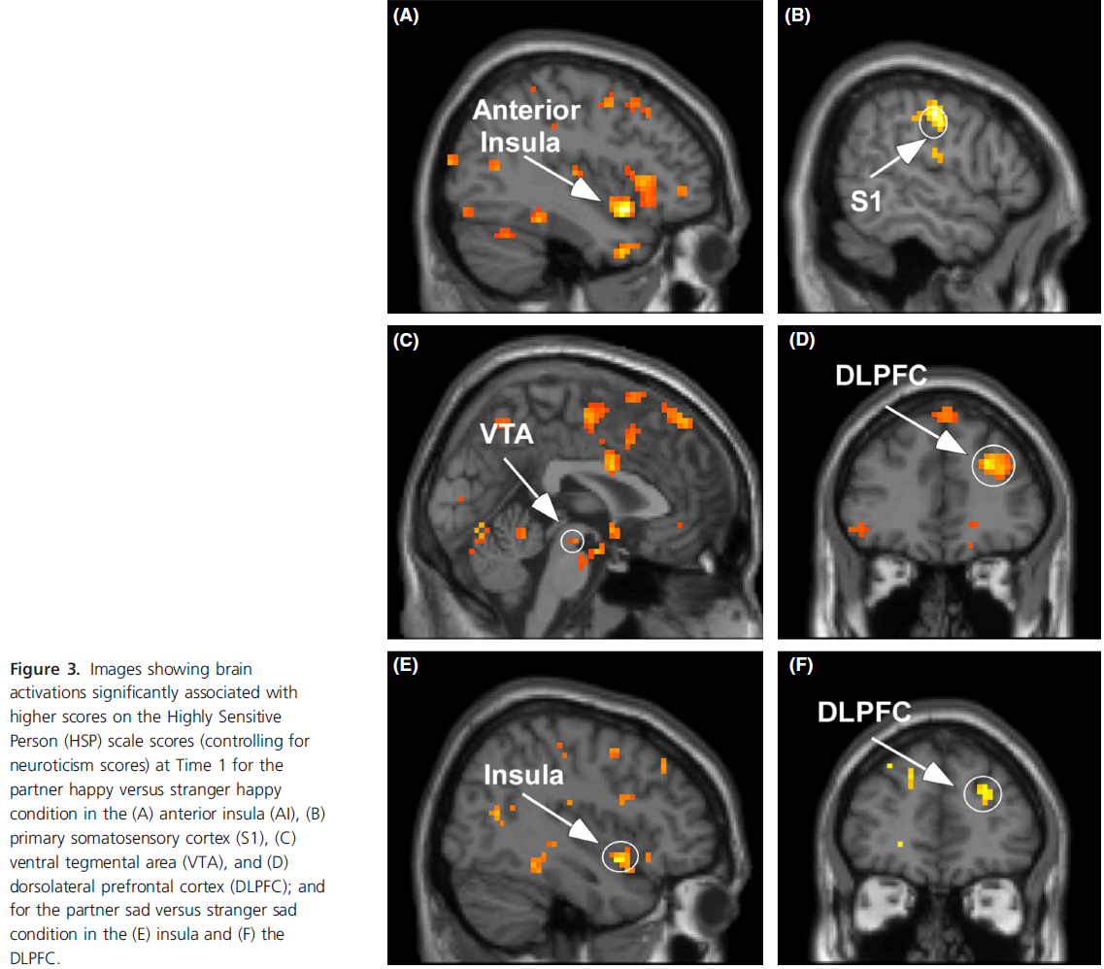
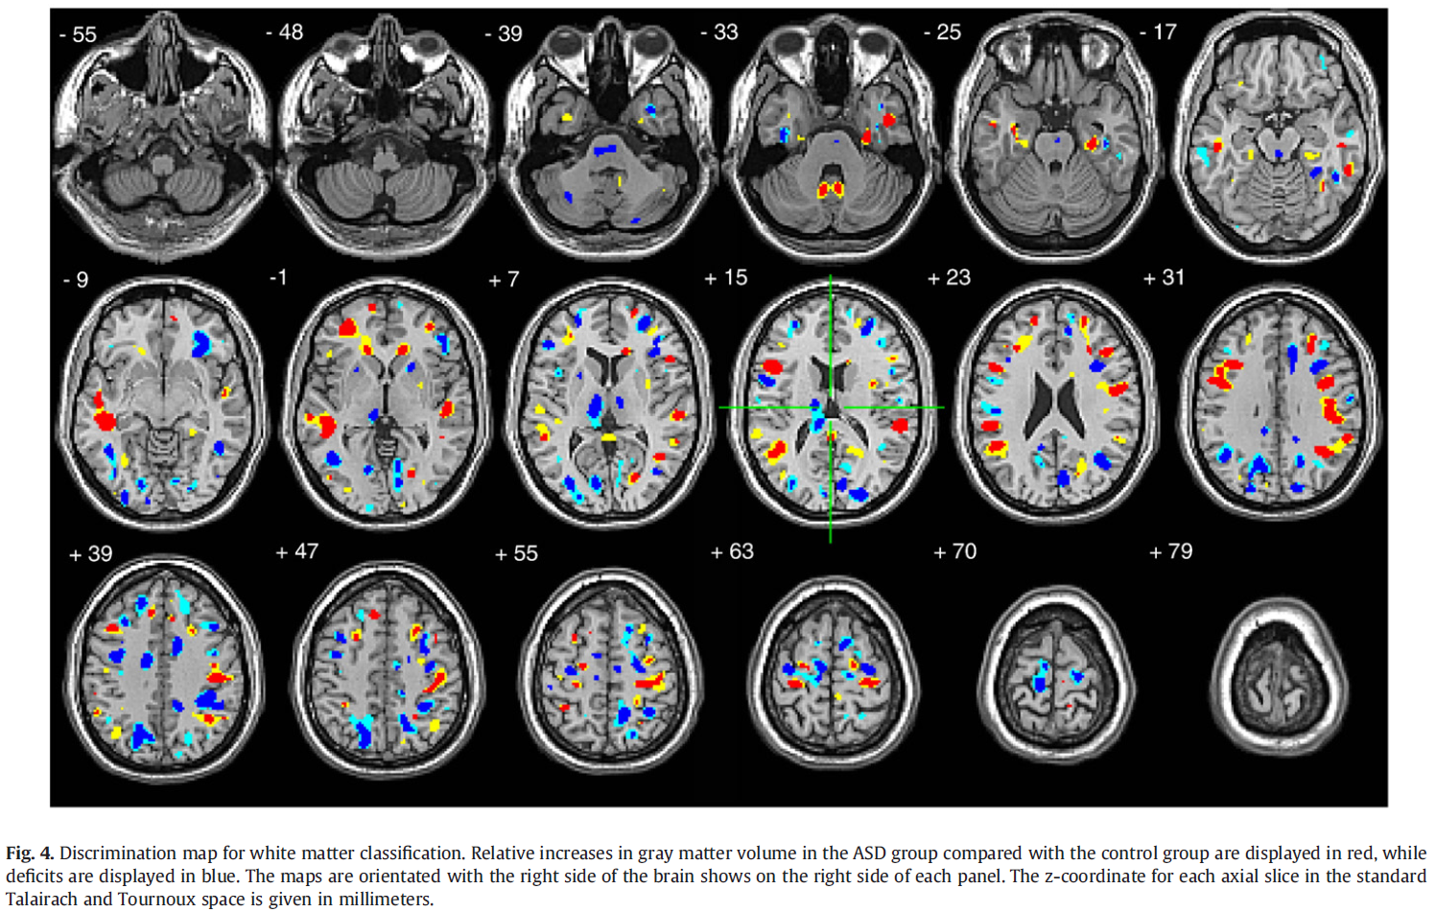
In many cases, it’s more than just preferences
Empaths show different brain activity in response to a loved one’s emotional state.
People with autism have brains that function in a physically different way. These MRI scans show people with autism, compared to a control group.

Slide 9
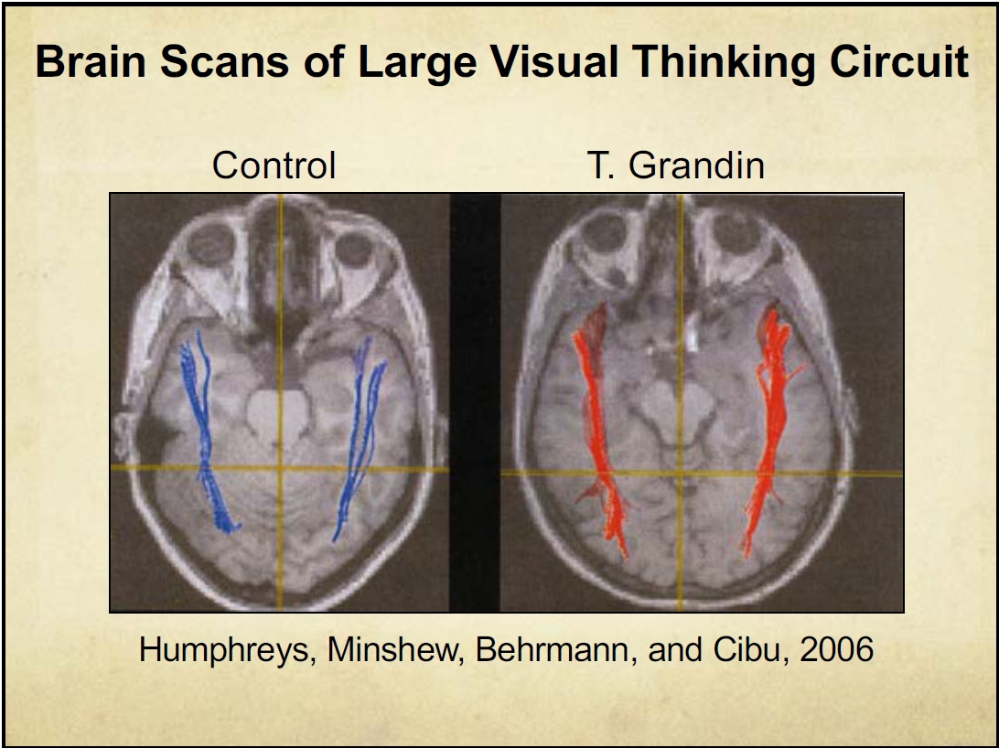
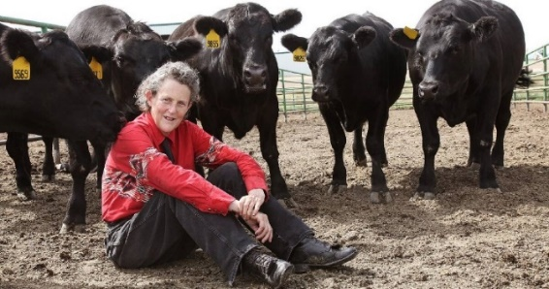
In many cases, it’s more than just preferences
This simpler brain scan helps to illustrate what neurological difference can look like. In this case, an FMRI scan of an exceptional visual thinker.
Control
A Visual Thinker (Temple Grandin)
Temple Grandin’s keen observation of animal behaviour improved livestock handling practices, resulting in more efficient and humane processes. This had an immediate impact on product quality.

Slide 10
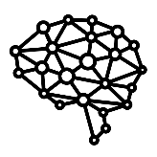

But we have a problem
Numbers of impacted staff
In most organisations, more than half of people in technical roles are likely to have at least a mild form of autism.
Most moderately-sized organisations have an IT area, and in most of those, technical people generally make up at least half of the people in IT. So, if the IT part of an organisation has 400 people, then a minimum of 100 people in the autism would be likely to have autism. Minimum.
This is before we factor in all the other disciplines in which the skills that autism infers are likely to be needed – finance, law, IT, organisational design, science, engineering etc.
The way we engage, recruit and evaluate our staff seems to value only on certain parts of this spectrum.
Our current ways of working in effect exclude the expert systems specialists we depend on.
Recruitment and staff promotion
Current staff management practices effectively assume that neurotypical communications ability and idiosyncrasies are the best filter for valuing our staff.
As a result, those who can’t communicate well with neurotypicals are treated as less valuable, even if they have precisely the skills we need.
Standard interview and promotion practices demand the skills that systems specialists don’t have, and effectively ignore the critical skills they do have. This has the potential to negatively impact alignment between skills needed and who is hired.
People Specialists
System Specialists
Implicitly excluded

Slide 11

Every point on this spectrum brings different skills – which add up to similar value
People Specialists
We have one group that is extremely good at intuitively understanding people, but not so good at understanding systems.
We have one group that is extremely good at intuitively understanding systems, but not so good at understanding people.
System Specialists
… and one group that has a little of both.
Our organisations need all three of these groups.
It needs their specialised expertise, and it needs to learn how to work around what they’re not good at to fully utilise what they’re exceptional at.

Slide 12


Bringing complementary skills together.
Two ways to utilise different skills in organisations.
Solutions
Complementary Skills Workshops
Idea translation workshops to understand and communicate existing complex ideas.
Genuine MDTs
Complementary Skills in MDTs to identify new ideas, insights and solutions.
People specialist insights
Systems specialist concepts
System specialists develop concepts (over weeks or years), then work with communication specialists to translate those ideas into forms that will work for general populations.
Genuinely Multi-Disciplinary Teams (MDTs) spanning disciplines and perspectives by combining complementary skills to create valuable new insights and holistic solutions.
Results in clear communication
Leads to diverse, new insightful ideas

Slide 13
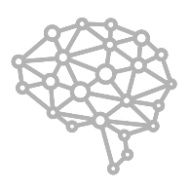


Three key points to take away
People have different valuable expertise
People have different brains, different expertise, and different value to organisations. The greatest value comes when we recognise, harness and utilise that difference.
We need to shift our mindset and our ways of working to seek out high-level expertise in areas we may not yet fully comprehend, and to understand, appreciate, develop and utilise the expertise we already have.
Communication gaps can be bridged with Complementary Skills
There are effective methods we can use to harness the value of different brains in the office.
Implementing Complementary Skills workshops and Genuine MDTs can help to bridge the gaps between technical experts and non-technical people.
Complementary Skills workshops can be used to translate existing complex technical concepts to a form that would suit a general audience.
Well-run Genuine MDTs can harness the value of different brains stimulating each other to create new insights, new approaches and new solutions to new and existing problems and opportunities.
We need to move beyond our current employment approaches
Our current employment and hierarchy practices do not cater well to the career progression of technical people.
Under the current system, if technical people seek to achieve an employment level in line with their true value to the organisation, they are required to become experts in communicating well with neurotypicals, and managing staff. This is not only very difficult for a person with autism, but also takes them away from their highest value activities – utilising their area of specialist expertise.
If we’re to attract and retain the expertise we need, we need to develop employment approaches and pathways that recognise and reward technical expertise.

Slide 14
Questions?
People have different valuable expertise
Communication gaps can be bridged with Complementary Skills
We need to move beyond our current employment approaches
For references, reasoning and responses, please go to www.chrismalcher.com and select “Different Brains & Complementary Skills“ (direct link).
Some secure corporate cyber security environments can sometimes block smaller sites such as this. If that happens, please use a personal device to access the site.

